Slide 1
PART A: Data Preparation Data Overview and Cleaning
Loaded my dataset and generated summary statistics for all numerical features.
Excluded non-numeric columns like ID and date are from analysis since they don’t contribute to prediction.
Identified missing values and duplicate records
Duplicates are removed and missing values were filled using the median of each feature.
Purpose
To ensure the dataset is clean, consistent, and statistically meaningful before modeling.

Slide 2
Scaling, Splitting andTarget Distribution
Key numerical features like bedrooms and bathrooms are scaled using standardization.
Split my dataset into 80% training and 20% testing.
Distribution of the target variable (price) is visualized.
Insights
House prices are typically right-skewed (very few expensive houses).
Purpose
Scaling ensures features contribute equally in regression.
Splitting allows fair model evaluation.
Understanding target distribution helps detect bias and skewness.

Slide 3
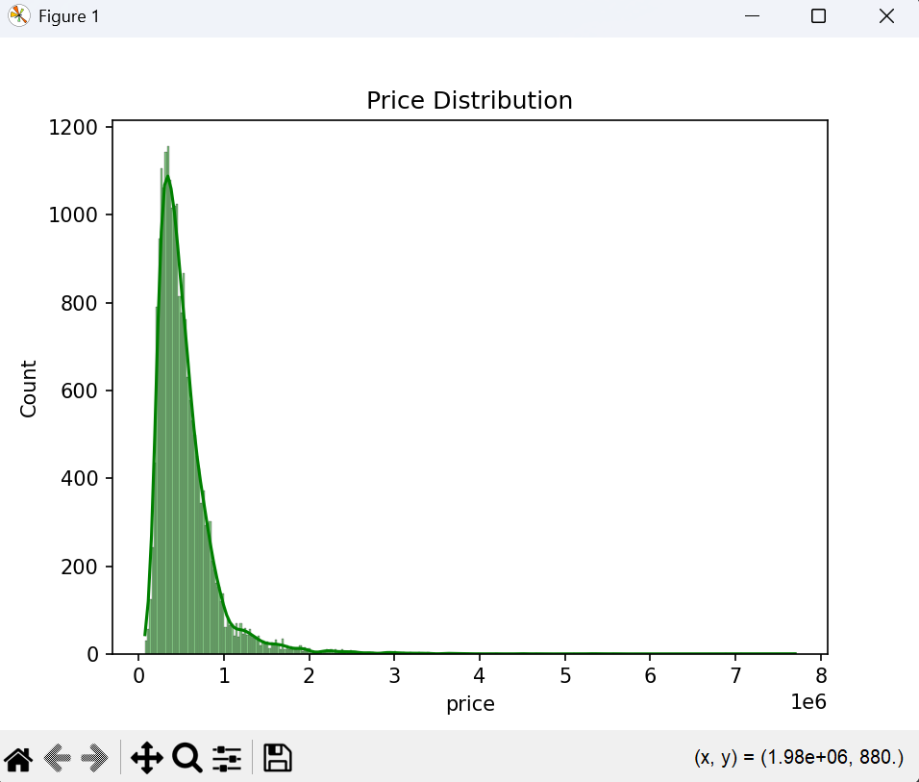
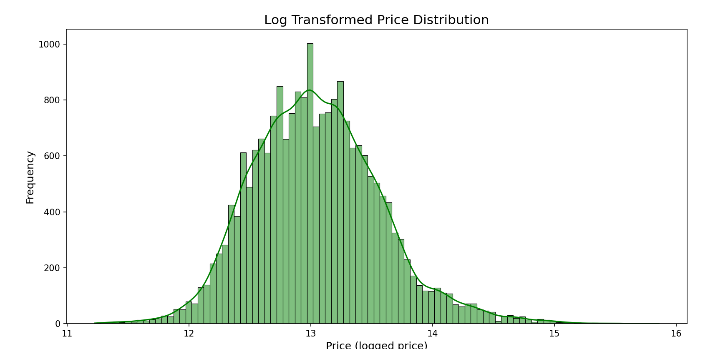
Distribution of the target variable(price)
Shape: The distribution has been transformed from Right-Skewed to Normal (Bell-Shaped). This creates a symmetrical distribution that is much better for model accuracy.
Central Tendency: The Mean, Median, and Mode are now closely aligned around the center (log-value of 13), indicating that extreme price outliers have been successfully normalized.
Data Density: Concentration is highest at the center of the bell curve. The thin long tail has been compressed, reducing the mathematical noise that previously confused the model.

Slide 4
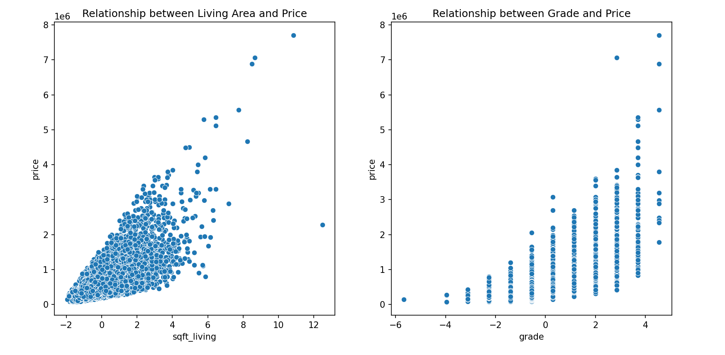
PART B: Exploratory Data Analysis Relationships and Correlation
Scatter plots
Positive Correlation: Both plots show that as the independent variable increases, the dependent variable also increases.
At the low end, the data is tight and follows a straight line closely.
At the high end, the data spreads out widely meaning the linear model becomes less certain or less accurate for expensive homes.

Slide 5
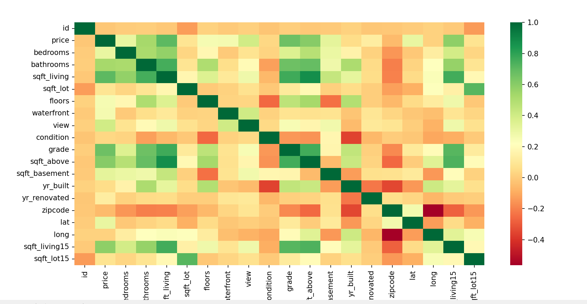
Correlation matrix
The heatmap reveals that sqft_living, grade, and sqft_above are the most influential factors in determining house prices. These features show the strongest positive correlation, meaning as these values increase, the house price significantly increaases.

Slide 6
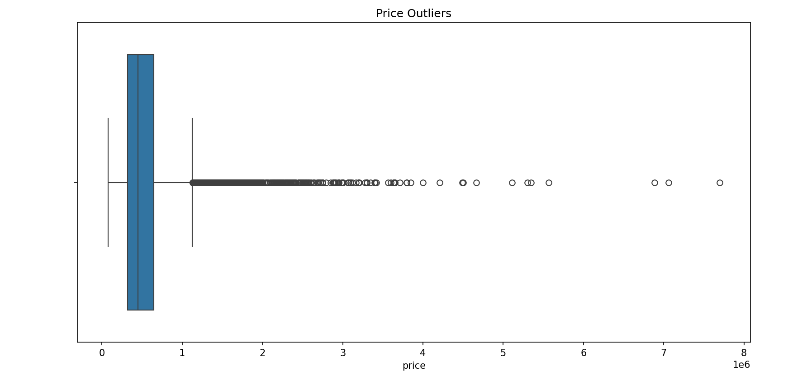
Feature Importance and Outliers
Impact of Outliers:
Can distort regression models
Lead to poor predictions for normal houses
Purpose: To guide feature selection and highlight potential data issues.

Slide 7
Guiding model decisions
Data Cleaning (Outlier Removal)
problem: Because the extreme outliers are rare, they will strongly pull the model’s best fit line upward, causing it to over-predict the price of average homes.
Action: We should filter the dataset to remove extreme outliers to improve the model's accuracy for the 95% majority of the market.
Feature Selection
problem: Since sqft_living and sqft_above are so similar, keeping both can make the model unstable and hard to interpret.
Action: We will drop redundant features and prioritize the one with the highest correlation to price (sqft_living).

Slide 8
PART C: Model Training Training Models
Trained two models:
Linear Regression (simple and assumes linear relationship)
Decision Tree Regressor (captures complex patterns)
Purpose:
To compare simple vs complex models for price prediction.

Slide 9
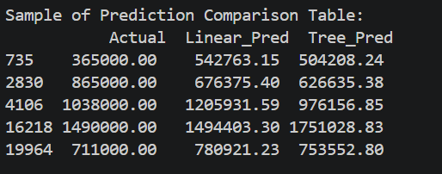
Model Comparison
Purpose: To evaluate accuracy, efficiency, and model behavior.

Slide 10
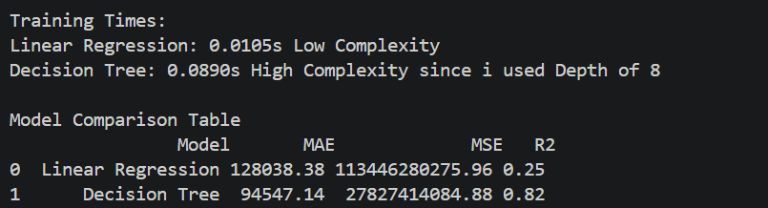
PART D: Evaluation and Error Analysis Performance Metrics
Insights:
Lower MAE/MSE = better predictions
Higher R² = better model fit
Decision Tree often performs better but risks overfitting
Purpose: To quantitatively compare model performance.

Slide 11
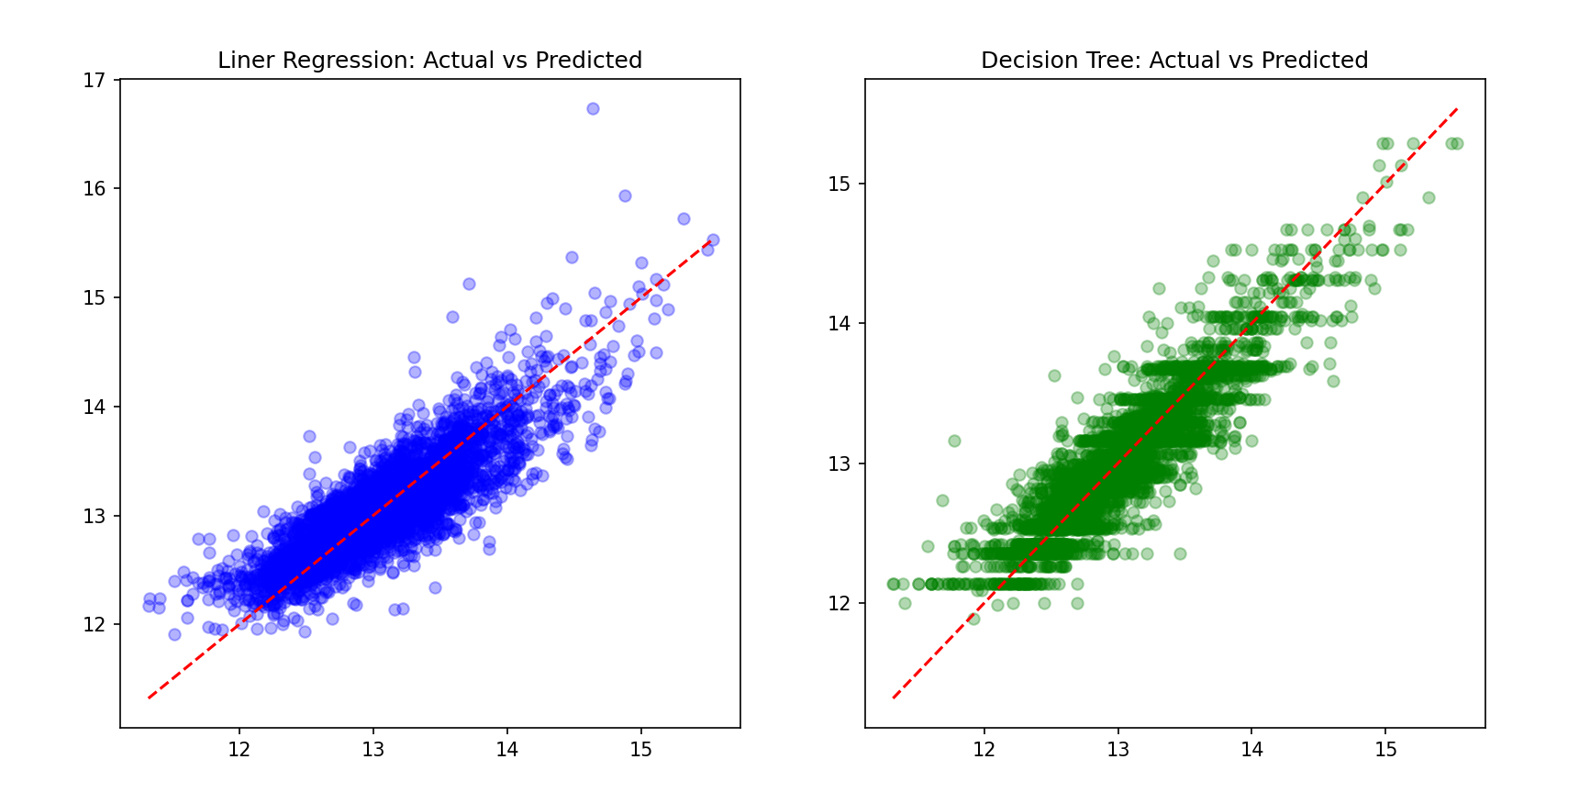
Residuals and Errors

Slide 12
The Red Line: This represents a Perfect Prediction. The closer the dots are to this line, the lower our error.
Linear Regression (Blue): Shows a consistent cloud around the line. However, the vertical spread at the high end (15.0) indicating that the model starts to struggle with very high-value properties even after log-transformation.
Decision Tree (Green): The dots are noticeably tighter to the red line in the middle range. This is typical for Decision Trees as it shows the model grouping houses into specific based on features
Error Patterns:
Expensive houses tend to be underestimated
Outliers cause large prediction errors
Cross-validation is used to test model stability:
Purpose: To understand model weaknesses and improve reliability.

